Slide 1
Data Source 5 - Isotopes
Environment Analysis
GA

Slide 2
Overview
Name of datasource: GA Portal
Description of datasource: Stable isotope data
Mainly Sr isotopes for regolith data, ? for hydro samples
All point data with location (lat,longs in GDA94)

Slide 3
Involved Persons
Name and email | Role
Geoff Fraser <Geoff.Fraser@ga.gov.au> | Director doe geochron and isotopes GA
aaron.sedgmen@ga.gov.au <aaron.sedgmen@ga.gov.au> | WFS/WMS data manager GA
Kathryn Waltenberg <Kathryn.waltenberg@ga.gov.au> | Regolith (rock/soil) isotope data
Steph Hawkins <steph.hawkins@ga.gov.au> | Hydro (water) isotope data

Slide 4
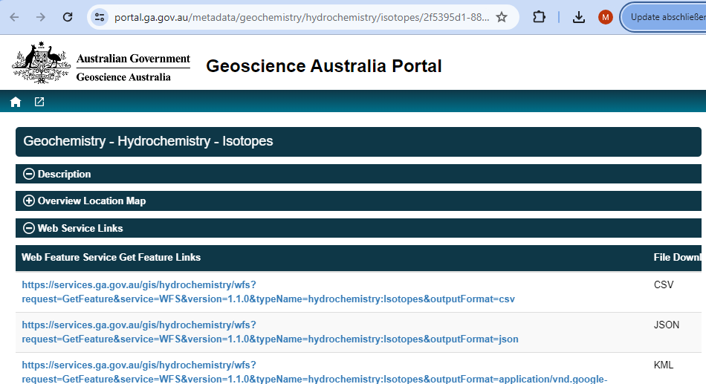
Data Access
Frequency: Monthly updates
Size: ~around 5000 samples?
How to access (sample code?):
On 2024-02-06 21:05, Flick, Lian (Data61, St. Lucia) wrote:
Geoscience Australia will connect data from 2 publicly available data sources:
Rb-Sr Isotopes in Regolith
https://portal.ga.gov.au/restore/822b9647-f9c6-4cea-a023-b3b4b7f6863a
https://services.ga.gov.au/gis/geochronology-isotopes/wms?request=GetCapabilities&service=WMS&version=1.3.0
https://services.ga.gov.au/gis/geochronology-isotopes/web/
Hydrogeochemistry – Isotopes https://portal.ga.gov.au/metadata/geochemistry/hydrochemistry/isotopes/2f5395d1-8849-404a-bf02-0b577f37a7ce
https://services.ga.gov.au/gis/hydrochemistry/web/

Slide 5
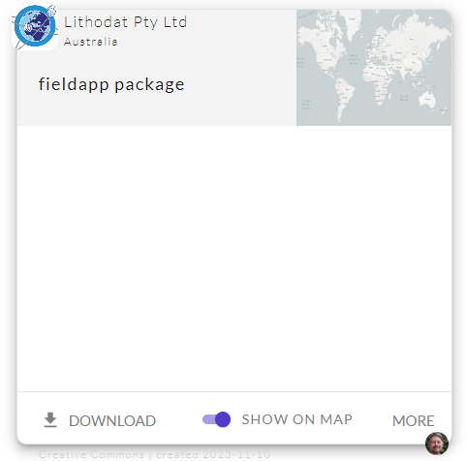
Package Konfiguration
Institution
Image
Title
Institution: Geoscience Australia
Title: Geochronology and Isotopes
Description: Analytical data tables for publicly available isotope data from Geoscience Australia (GA). Each result links to information about the sample, analytical metadata, and the source publication.
Image:
License: Creative Commons Attribution 4.0 International Licence
Description

Slide 6
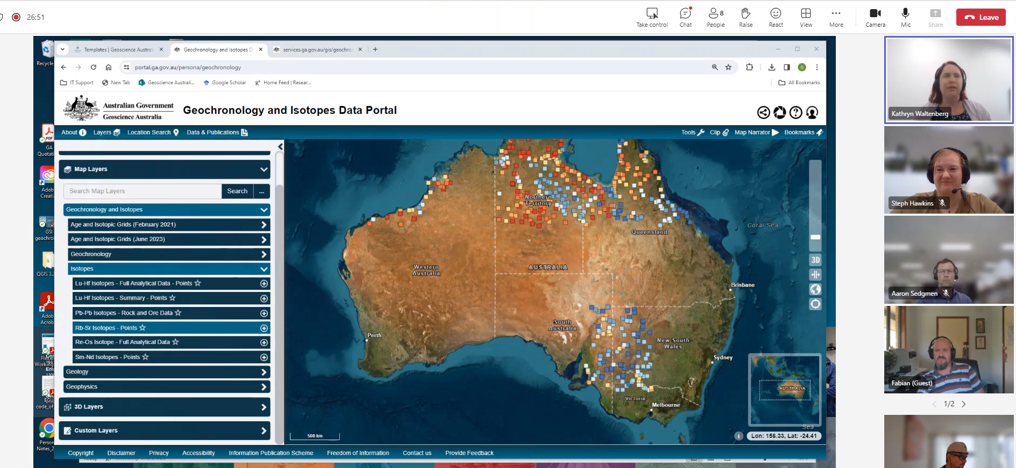
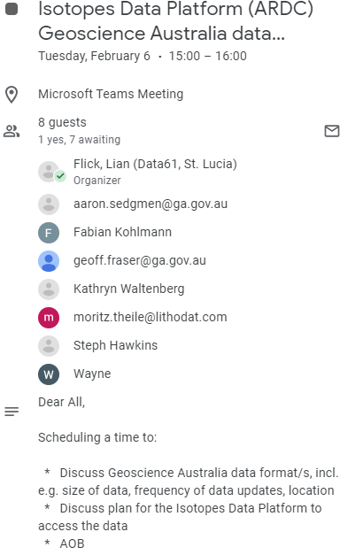
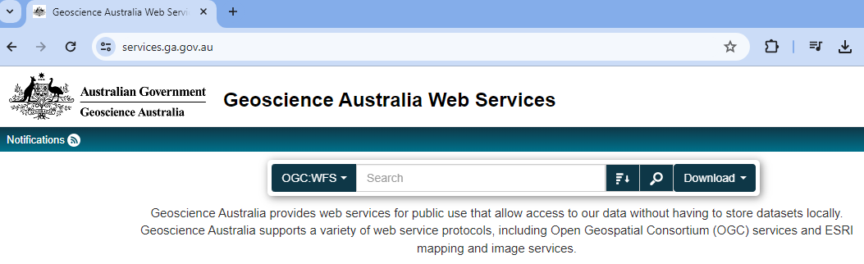
Meeting 2024-02-06
Video
00:08:50 How to access data on GA portal
https://services.ga.gov.au/gis/geochrology-isotopes/web
(see 00:16:30)

Slide 7
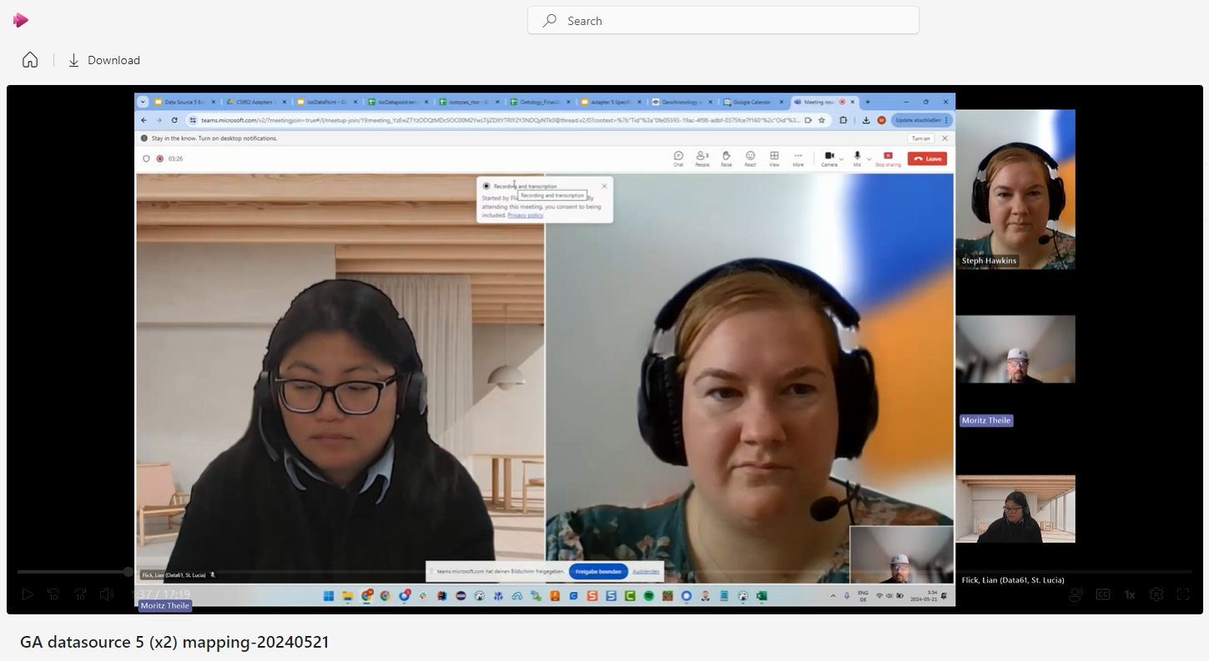
Meeting on 2024-05-20
Link to video (on Google Drive)
till ~05:00 recap
discussing mapping field by field
07:00 two data sources (Isotope and hydrochem)
11:00 starting of mapping (sampleName)

Slide 8
Meeting on 2024-05-28
Link to Video
Adapter 6 Mapping

